Slide 1


Project Presentation on Comprehensive Digital Learning System for Students
Guided By: Presented By:
Prof. Mahendra Verma Atharv Sharma
Abhishek Rathore
Jatin Rao
Harsh Suryavanshi
Ineesh Dubey

Slide 2
Contents
1. Methodology
1.1 Proposed Algorithm
2. Implementation Approach
2.1 Introduction to Languages, IDEs Tools and Technologies
3. Testing Approaches
3.1 Unit Testing
a. Test Cases
3.2 Integration Testing
b. Test Cases

Slide 3
Contents (Continued)
4. Results & Discussion
4.1 User Interface Representation
4.1.1 Brief Description of Various Modules
4.2 Snapshot of System with Brief Description
4.3 Database Description
4.3.1 Snapshot of Database Tables with Brief Description
4.4 Final Findings
5. Conclusion & Future Scope
5.1 Conclusion
5.2 Future Scope

Slide 4
1. Methodology
1.1 Proposed Algorithm
The project will use structured algorithms to ensure efficient searching, uploading, and peer reviewing of study notes.
Algorithms include:
• Keyword-based search: For optimized note retrieval.
• Ranking system: Peer-reviewed notes ranked based on ratings and relevance.
• Content categorization: Notes organized by subject, topic, and difficulty level.

Slide 5
2. Implementation Approach
2.1 Introduction to Languages, IDEs Tools and Technologies
Front-End Development:
• Languages: HTML5, CSS3, JavaScript.
• Frameworks: Bootstrap for responsive design.
Back-End Development:
• Languages: Python (Django) or PHP.
• Database: SQLite/MySQL for storing user data and notes.
Development Tools:
• IDE: Visual Studio Code or PyCharm.
• Hosting Platforms: AWS or local servers.
• Version Control: GitHub repository for tracking development.

Slide 6
3. Testing Approaches
3.1 Unit Testing
Objective: Validate individual functions/modules.
Example Test Cases:
• Login functionality for various user credentials.
• Upload/download process for study notes.
3.2 Integration Testing
Objective: Ensure modules work cohesively.
Example Test Cases:
• Database interaction with the user interface for searching and storing notes.
• Collaboration features like commenting and discussions.

Slide 7
4. Results & Discussion
4.1 User Interface Representation
This section presents the visual and functional aspects of the system interface, designed to make digital learning more accessible and effective for students.
4.1.1 Brief Description of Various Modules
The system consists of the following key modules, each designed to enhance the learning experience:
Login and Registration Module
Purpose: Allows new users (students, teachers, and administrators) to register and existing users to log in securely.
Features: Includes email verification, role-based access, and password recovery options.
Course Management Module
Purpose: Enables administrators and teachers to upload, organize, and manage course content.
Features: Support for multimedia files (videos, PDFs, quizzes), course categorization, and scheduling.

Slide 8
Student Dashboard Module
Purpose: Provides students with a personalized dashboard displaying their enrolled courses, progress, assignments, and upcoming deadlines.
Features: Includes notifications, progress tracking, and feedback integration.
Assessment Module
Purpose: Facilitates the creation and management of quizzes, assignments, and exams for students.
Features: Auto-grading for quizzes, plagiarism detection for submissions, and detailed performance reports.

Slide 9
Communication Module
Purpose: Enhances interaction between students and teachers through discussion forums, chat, and announcements.
Features: Real-time messaging, email notifications, and group discussion boards.
Reports and Analytics Module
Purpose: Provides insights into student performance, course popularity, and overall system usage.
Features: Exportable reports, visual analytics, and comparative performance analysis.

Slide 10
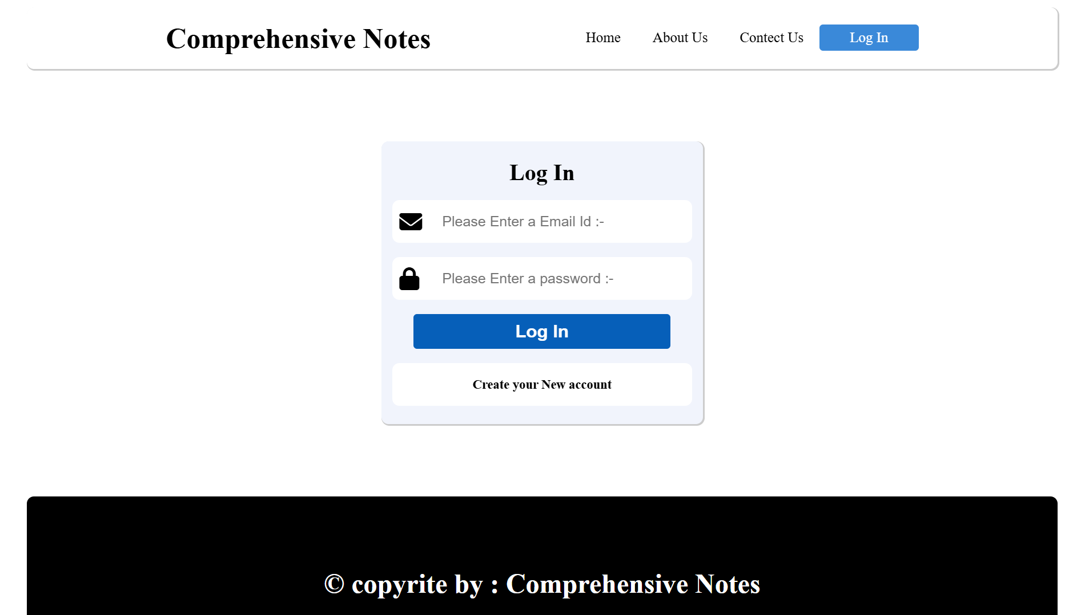
4.2 Snapshot of System with Brief Description
This subsection includes screenshots and brief descriptions of key system components to illustrate its functionality:
1. Login Page Description: The login page serves as the entry point to the system, requiring users to input credentials. It supports user roles (student, teacher, administrator) and error handling for incorrect entries.

Slide 11
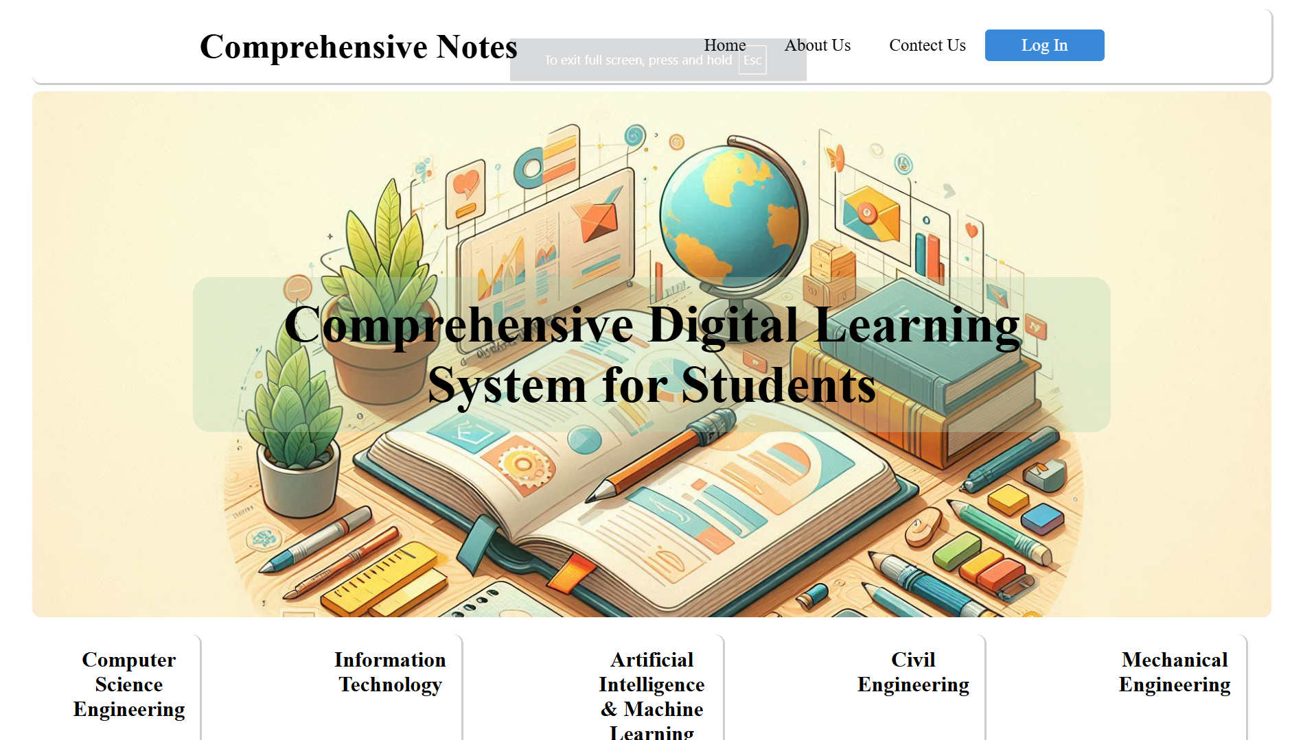
Student Dashboard Description: The dashboard displays a personalized summary of the student's courses, progress, and assignments.

Slide 12
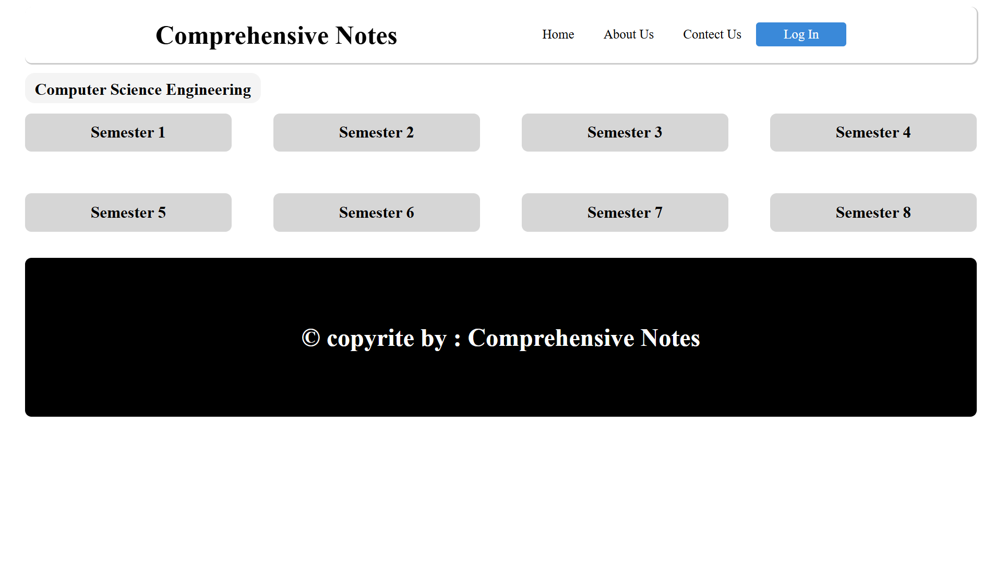
Course Page Description: The course page includes detailed lessons, assignments, and quizzes. It supports multimedia content and real-time collaboration tools.

Slide 13
4.4 Final Findings
The system effectively organizes and retrieves study materials.
User engagement through collaboration features ensures a diverse and enriched learning experience.

Slide 14
5. Conclusion & Future Scope
5.1 Conclusion
• The platform provides an accessible, reliable, and interactive space for students to access study materials.
• Collaboration features and responsive design enhance the user experience.
5.2 Future Scope
• AI Integration: Use machine learning to recommend personalized study materials.
• Gamification: Add rewards for contributions to encourage participation.
• Mobile Application: Develop an app for better accessibility.

